Slide 1







Salinity has a stronger effect on bacterial than protist beta but not alpha diversity in the DNA-monitored Baltic Sea
2025-02-05
Krzysztof T Jurdzinski, Meike AC Latz, Anders Torstensson, Sonia Brugel, Mikael Hedblom, Yue O O Hu, Markus Lindh, Agneta Andersson, Bengt Karlson, Anders F Andersson
Notes:
Hello everyone! My name is Krzysztof Jurdzinski, but you can just call me Kristoff. I am a PhD student at KTH in Anders Andersson’s lab, and the work I will talk about today comes from a collaboration with Swedish Meteorology and Hydrology Institute and Umeå University.
It is a comparative analysis of bacterial and protist plankton diversity, across space and time, in the Baltic Sea area. It is also part of a project in which DNA metabarcoding has been temporarily integrated into Swedish coastline monitoring.

Slide 2
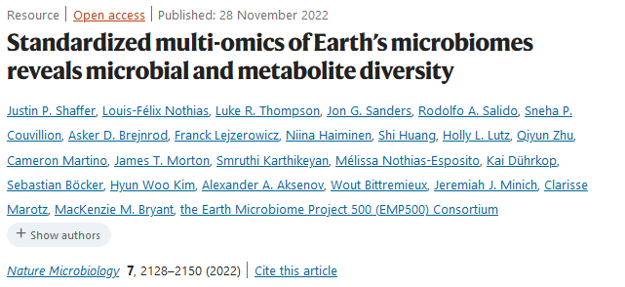
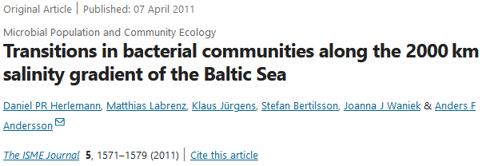
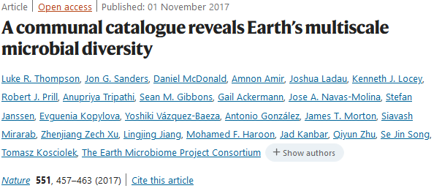
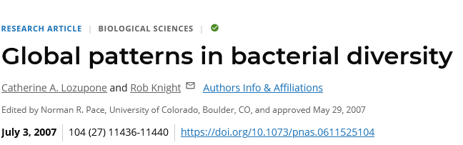
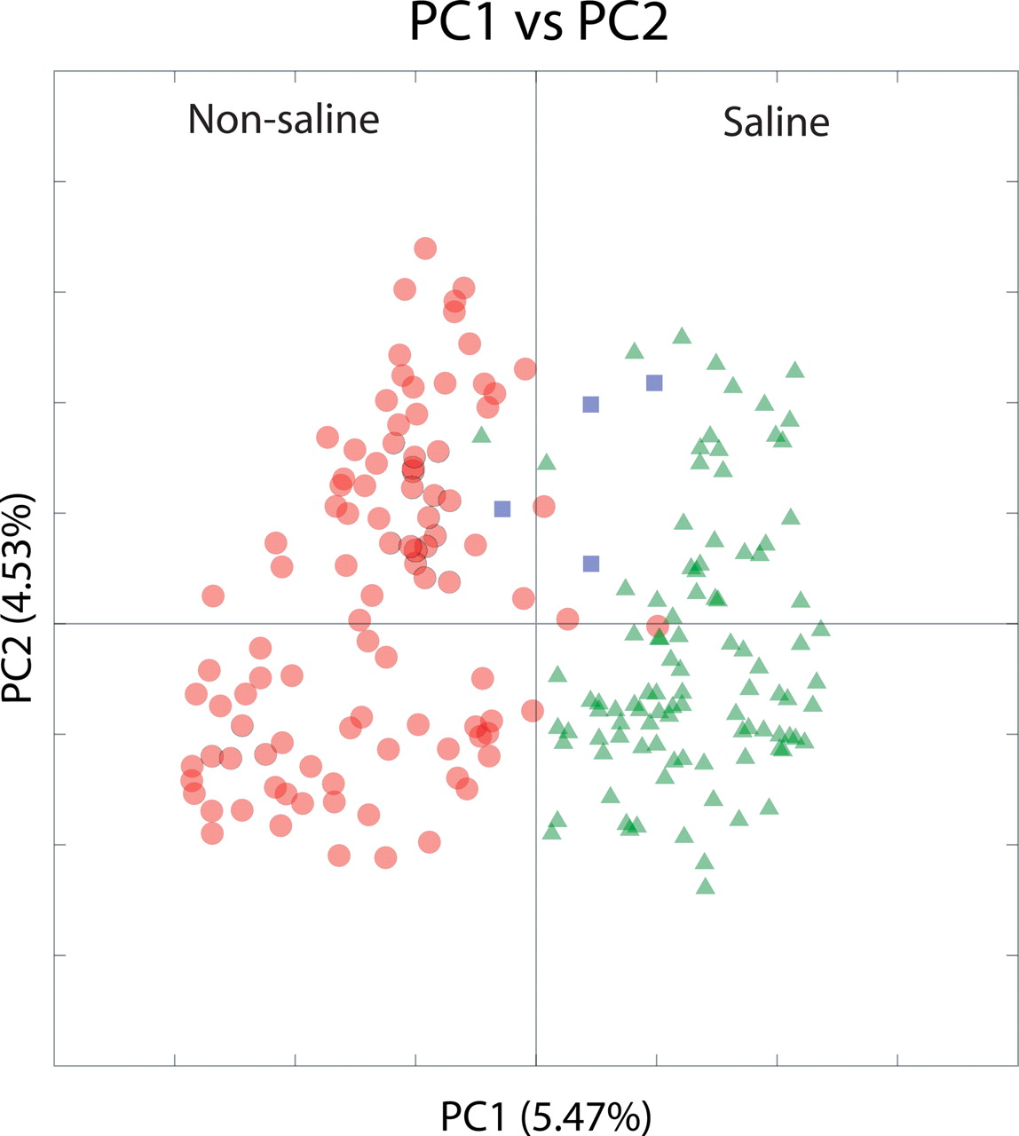
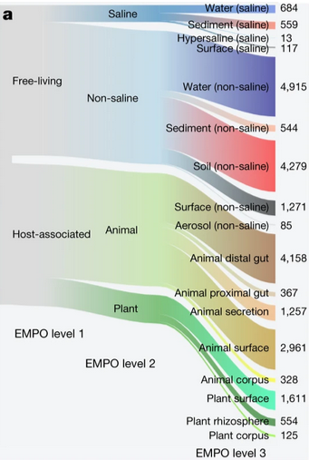
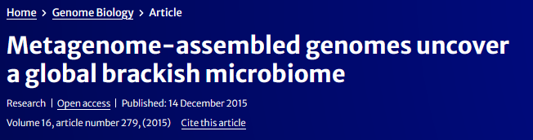
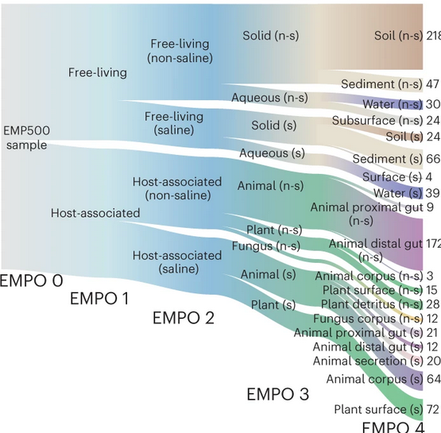

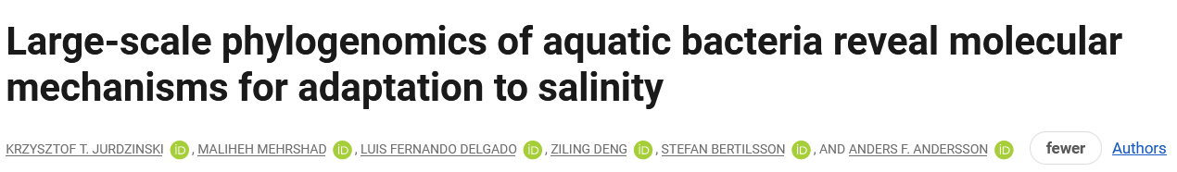
Salinity as the major environmental factor determining the distribution of free-living bacteria
Notes:
The pronounced salinity gradient and recent salinization might well be the most unique thing about the Baltic Sea. It also happens so that salinity seems to have an immense effect on the distribution of bacterial taxa. Since the earliest global surveys of bacterial diversity, it turned up as the major factor influencing community composition. In the following surveys, it remained the strongest factor for free-living bacteria, and even for the host-associated ones. Now, that has been very much based on the division between freshwater and marine environments. Now, what about the brackish waters, characterized by salinities in-between? This is what my supervisor, Anders Andersson, has pioneered. From showing how bacterial communities change across the brackish salinity gradient, through showing that brackish waters hold globally distributed bacterial species distinct from freshwater and marine ones, to uncovering molecular adaptations and evolutionary dynamics of transitions between one salinity regime – for example, brackish – and another – for example, freshwater. And in this study, we also tackle another major microbial group, that is, the single-celled eukaryotes, or protists.

Slide 3
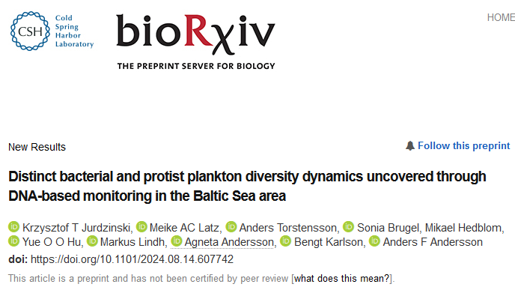
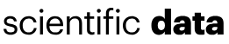
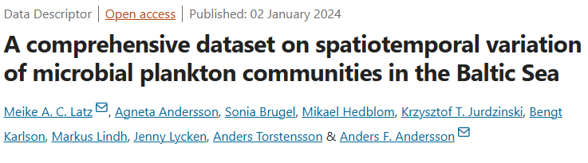
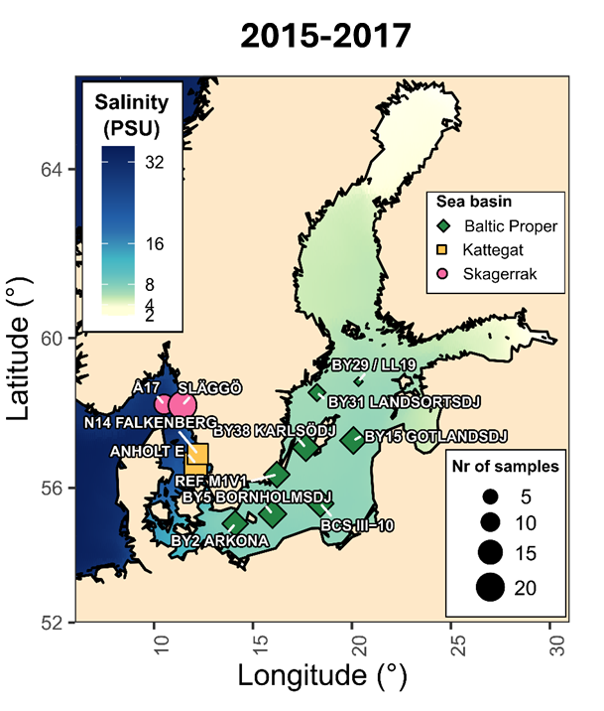
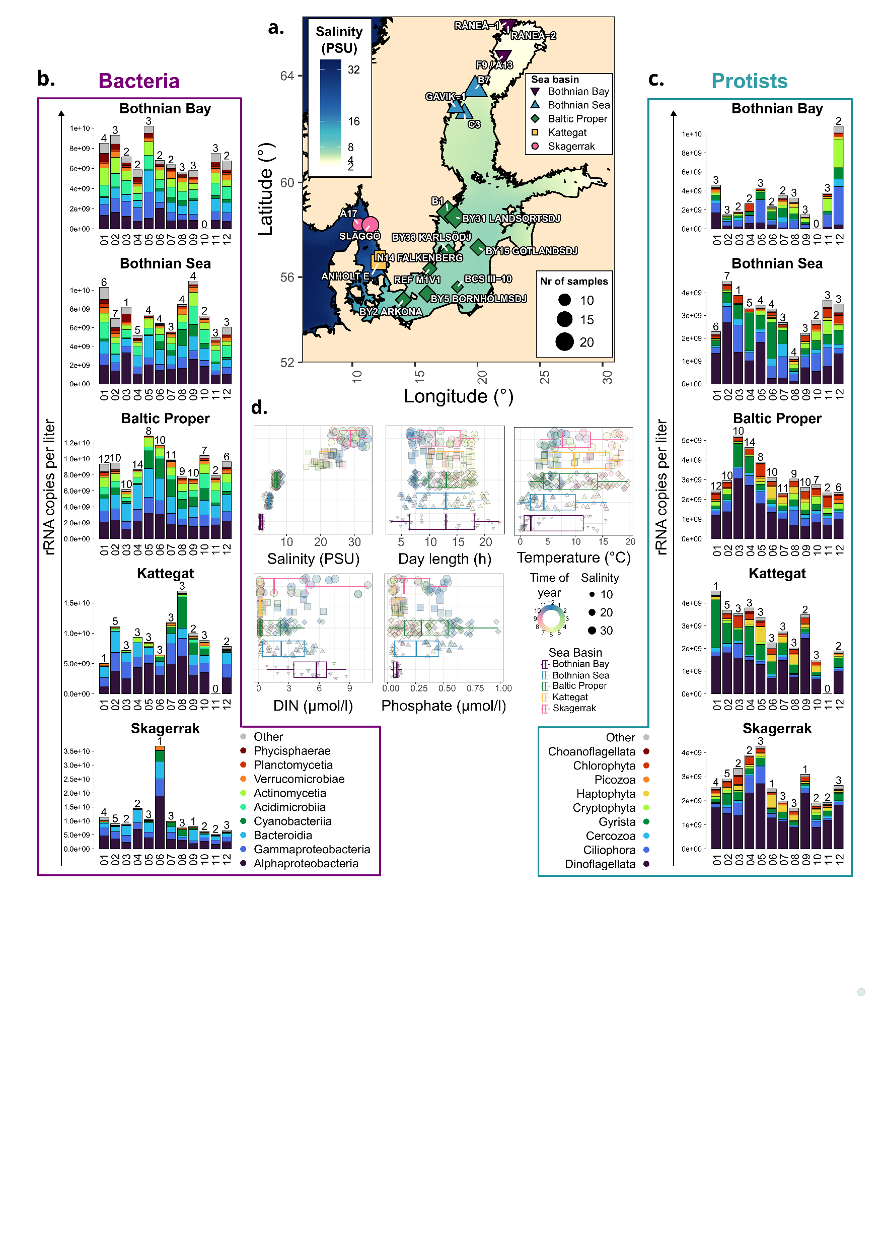
2019-2020

Slide 4
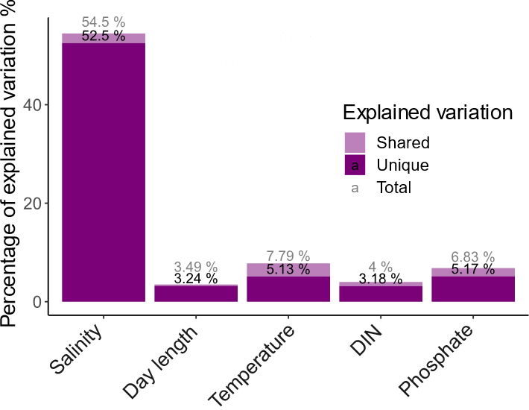
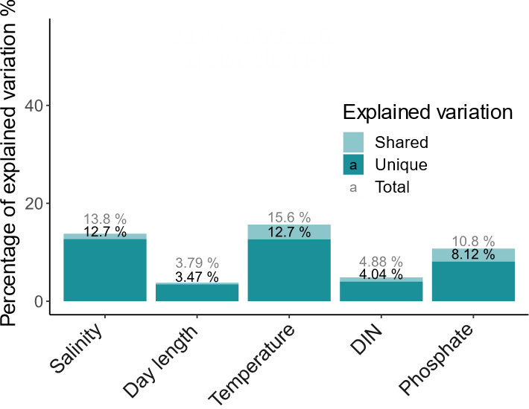
Salinity has a dominant impact on bacterial but not protist community composition
Bacteria
Protists
Notes:
The first thing we look at is beta diversity. How similar are the microbial communities across space in time in the Baltic Sea area? It turns out that, consistent with previous results, bacteria largely follow salinity. However, salinity has a much lower impact on protist communities, despite other factors being at least as influencial as for bacteria.
I will come back to beta diversity more in detail in a moment…

Slide 5
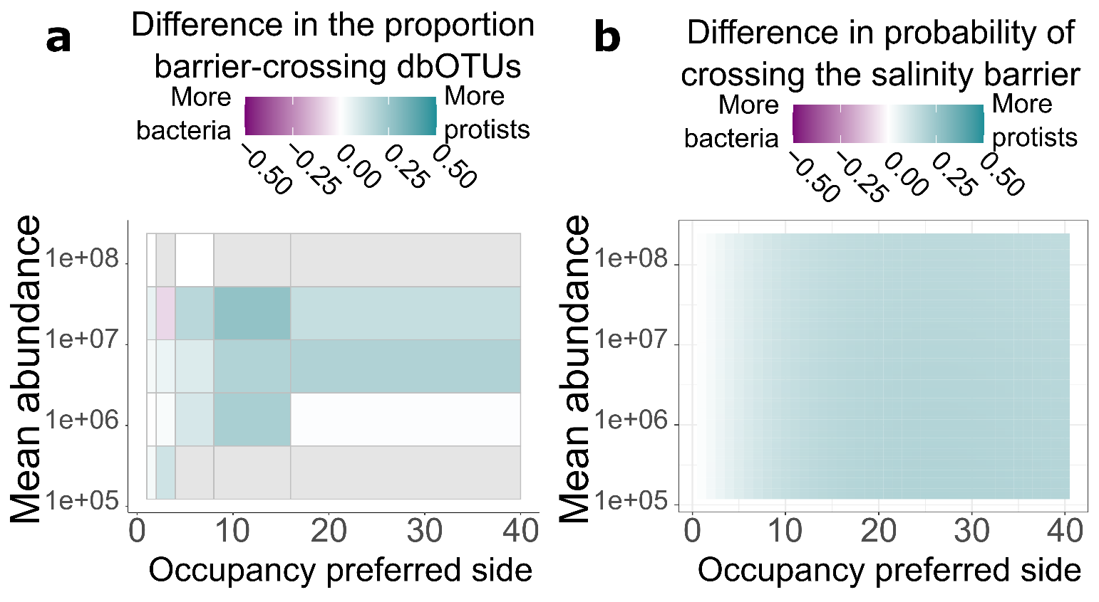
Protist more often cross the salinity barrier
Notes:
So, across the salinity barrier between the Baltic Sea and the Kattegat-Skagerrak, we have seen bigger changes in beta diversity for bacteria, but across the same barrier, protist alpha diversity changed more. Does that mean that abundant bacteria and rare protists are the groups most affected by salinity? Not at all! Across abundance and occupancy values, it was protists that were more likely to cross the salinity barrier, both based on raw data and a Bayesian model. Therefore, both in terms of community composition and the present taxa, salinity affected bacteria more than protists. The remaining question is…

Slide 6
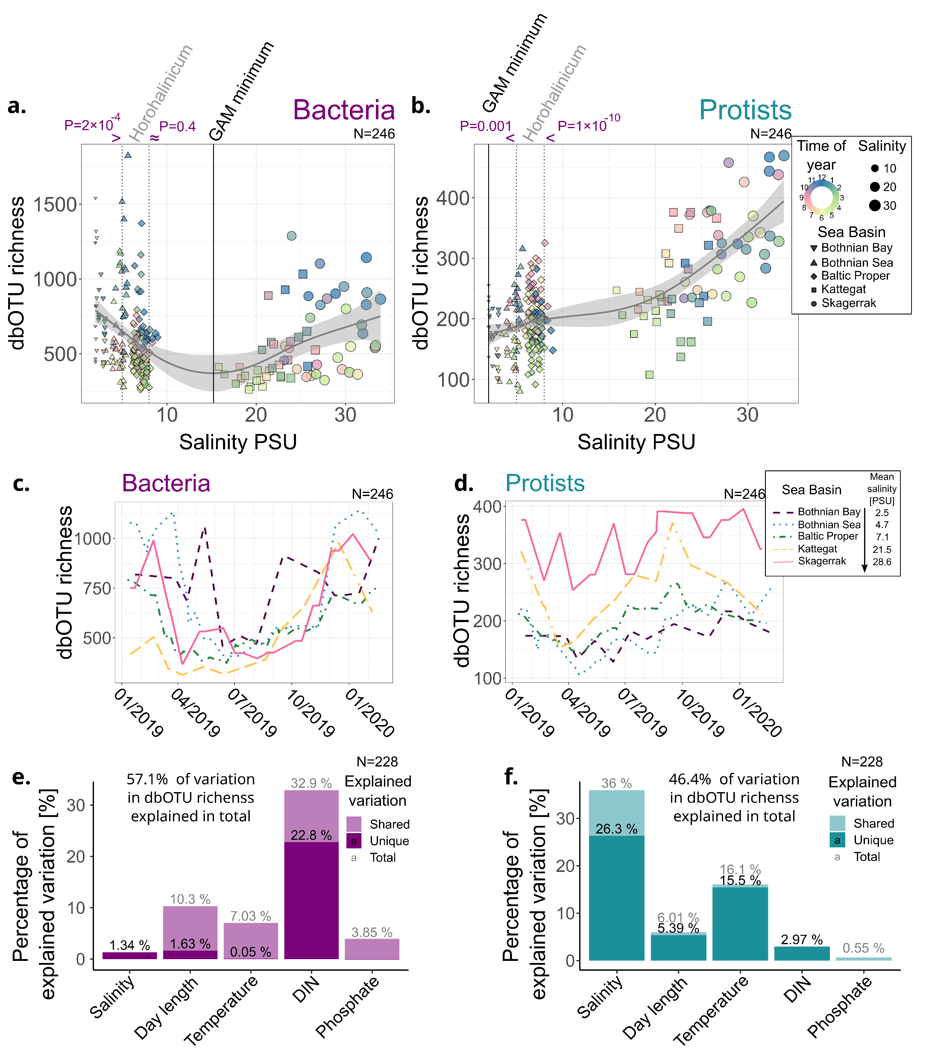
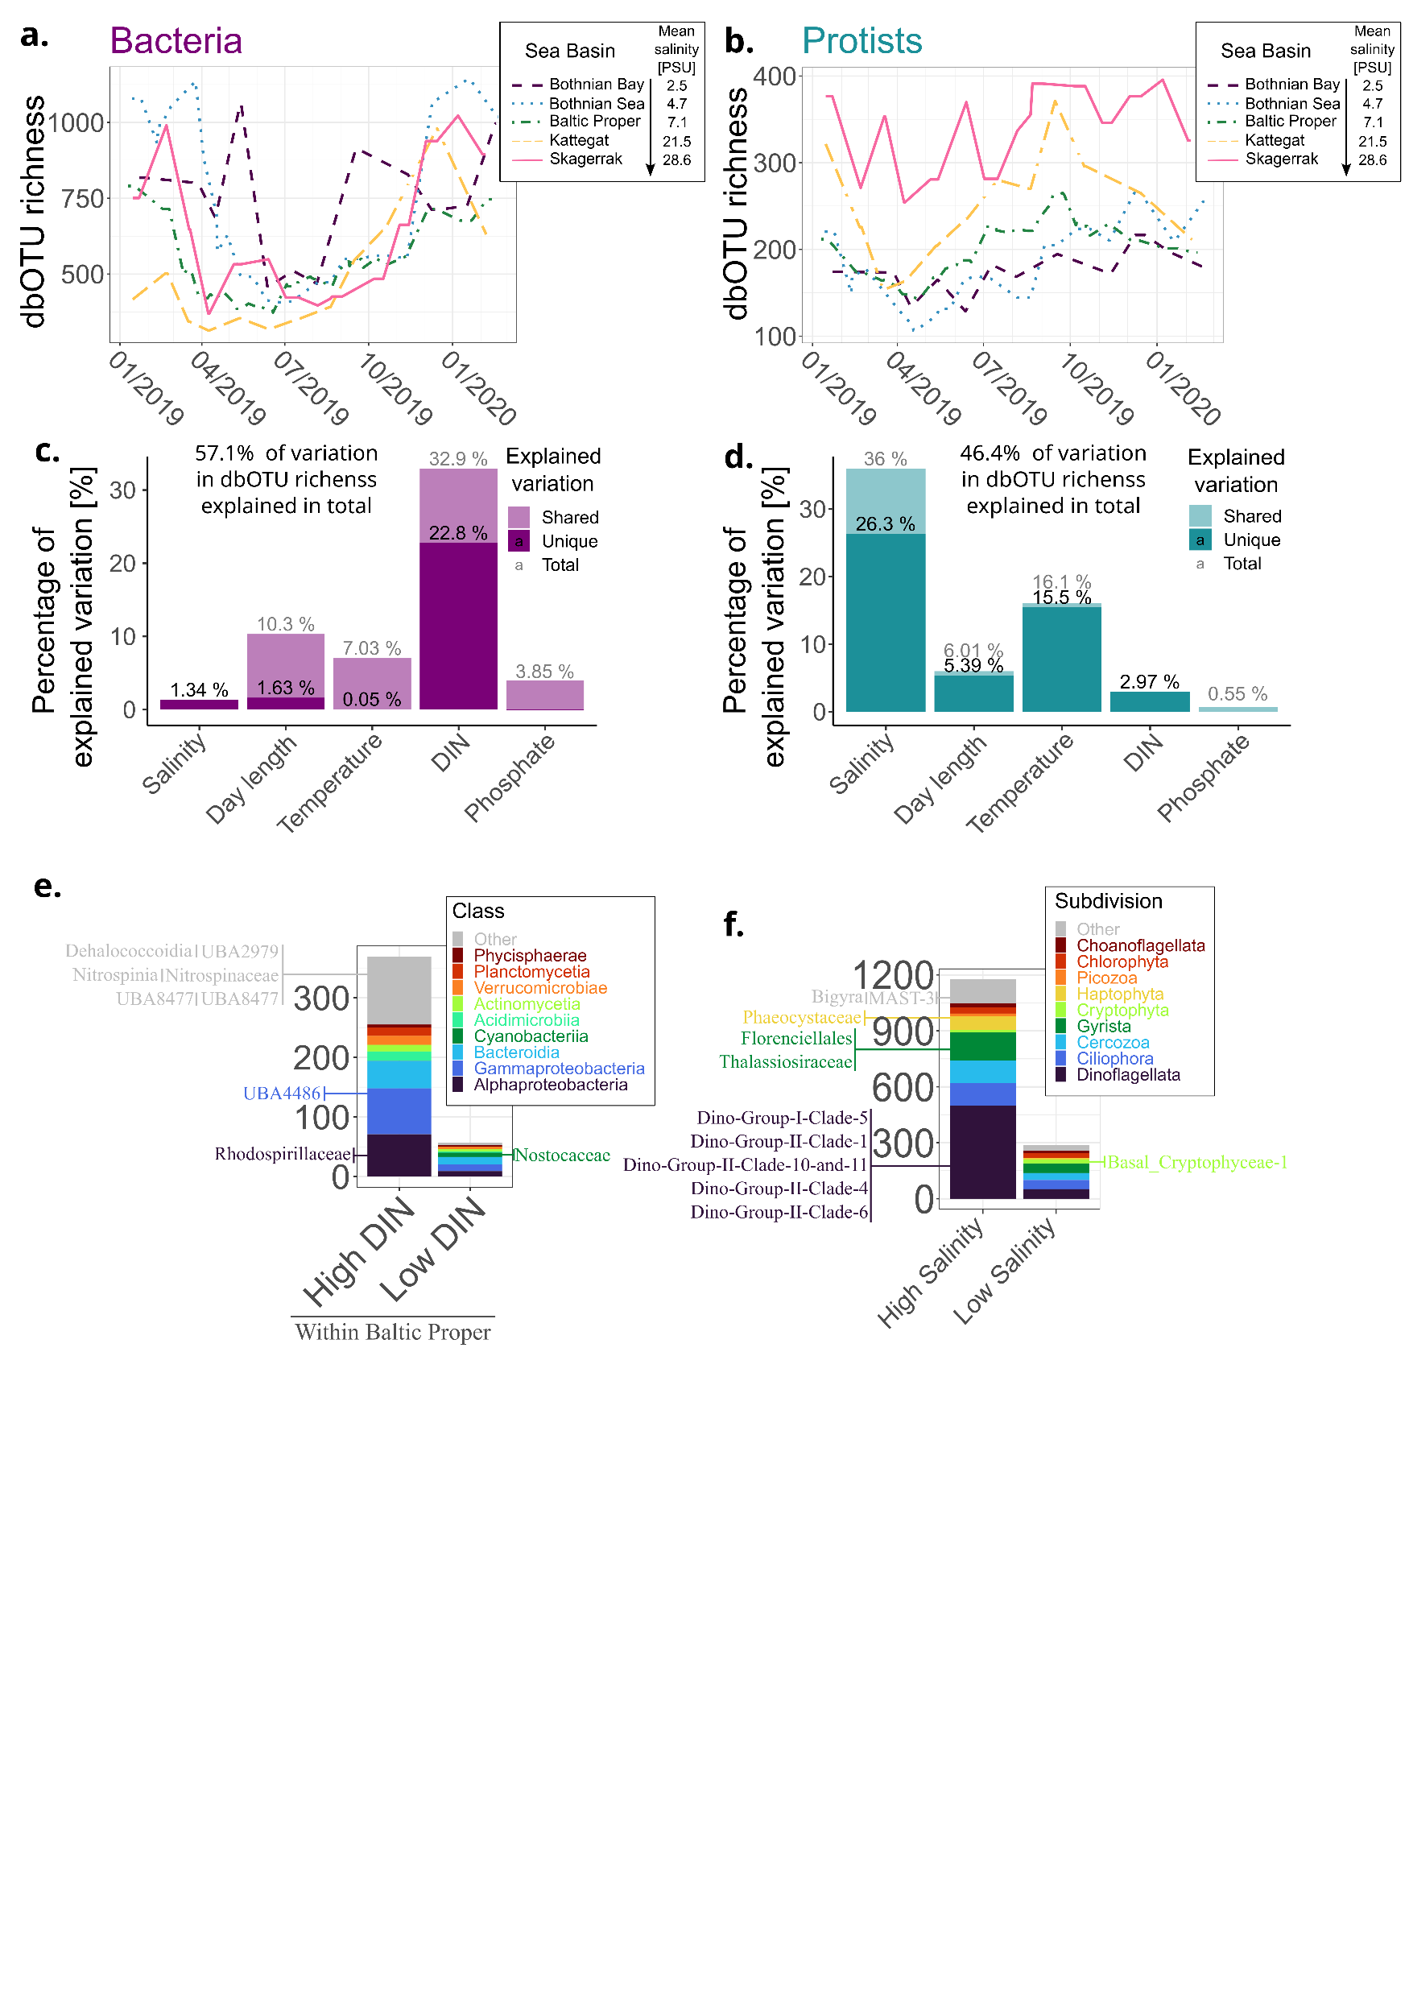
Protists are more diverse in near-marine salinities
Notes:
What about protists? Here, the main pattern was geographic and followed the salinity gradient, with the most saline Kattegat and Skagerrak also being the most diverse regions. Now, this is analogous to the diversity patterns for many animal groups, and we propose an analogous explanation. That is, many marine species adapted to the environment in Kattegat-Skagerrak but fewer to the conditions further down along the salinity gradient in the Baltic Sea. At the same time, the number of adapting marine species was larger than that of freshwater species. Whether this is actually the case, further research will show.

Slide 7
Bacterial alpha-diversity follows primarily seasonal patterns…
Notes:
Now that allows us to move into alpha diversity. How many lowest-level taxa – called dbOTUs in this case – could we find in a sample? For bacteria, if we just run linear correlation, dissolved inorganic nitrogen by far correlated best with alpha diversity. And we can see that this corresponded to seasonal variation rather than stable differences between the regions (so, each line on this graph is a rolling mean for a region). But was DIN really causing this seasonal vartiation?

Slide 8
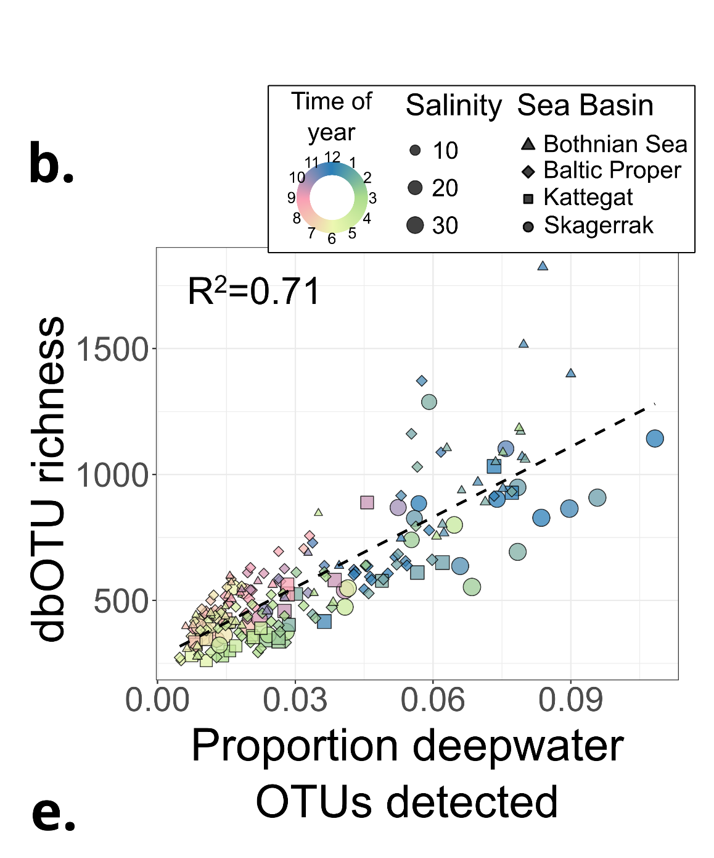
…which can be explained by convective vertical mixing in winter
Using data from Herlemann et al. 2016
Notes:
A well-discussed confounding factor would be convective mixing, the idea being that it brings extra taxa to the surface from deeper waters. To test that, we used data from yet another previous paper, where they did winter and summer transects with depth profiling. And what we get is that the proportion of deepwater taxa from the previous study found in our surface water samples correlates with alpha diversity much better than any of the physicochemical factors we assessed. What is more, once we correct for the presence of deepwater taxa, the DIN no longer associates with bacterial alpha diversity.

Slide 9
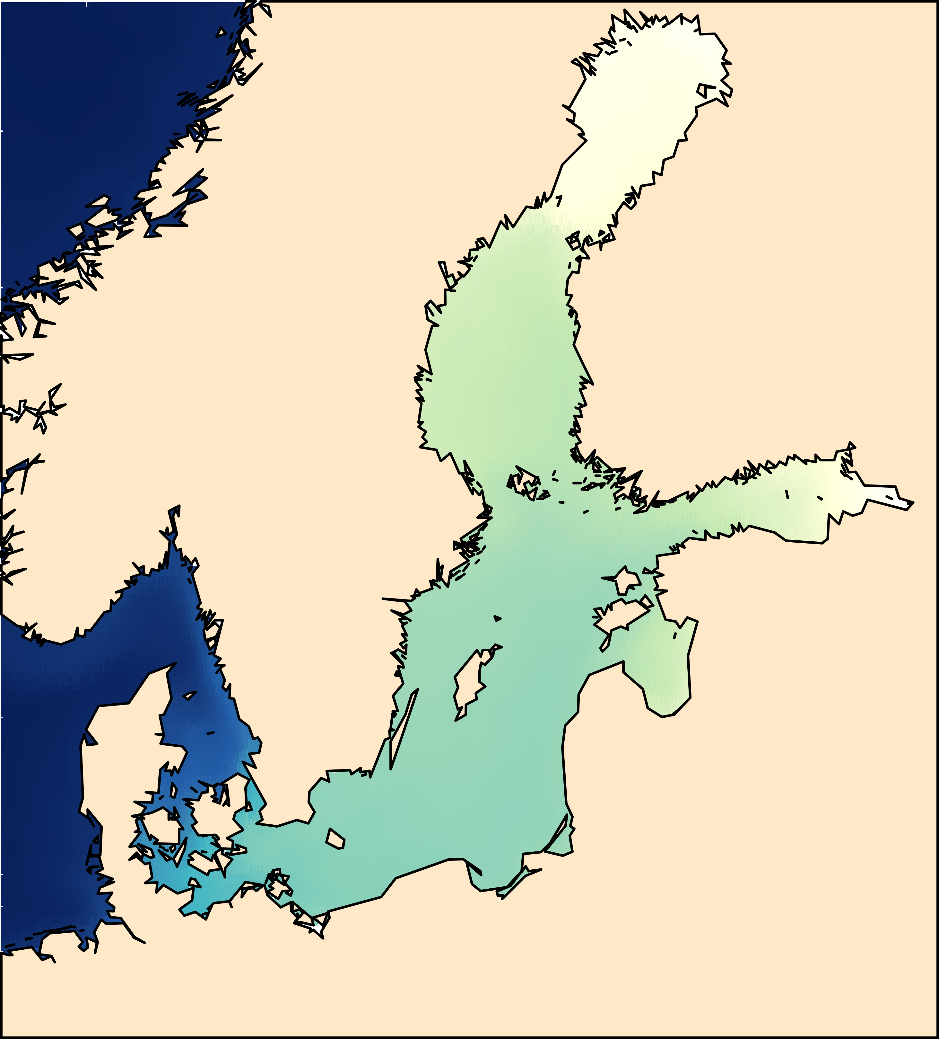
Protists but not bacteria are more diverse in near-marine salinities
Salinity effects on community composition are larger for bacteria than for protists

Slide 10


Conclusions
Protists community composition changes less with salinity than bacterial ones.
Bacterial diversity changes mainly seasonally, being higher in winter when vertical mixing reaches deeper.
Protist diversity increases with salinity in the Baltic Sea.
Personal website
KTJ microbes
ktjmicrobes.com

